Slide 1

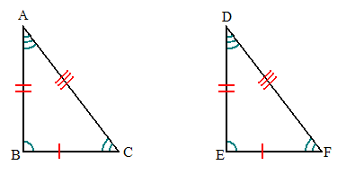
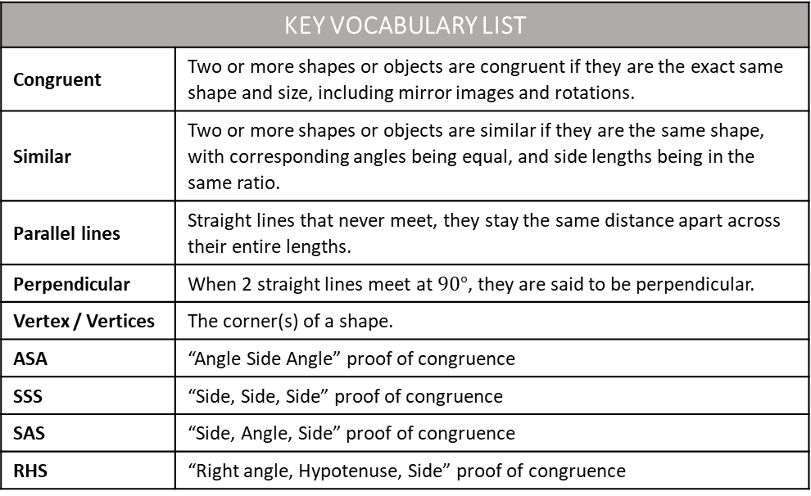
ANSWERS
Name
Class
Tutor Group
YEAR 11 MATHEMATICS
Unit 5b – Congruence and Congruence Proof
KEY VOCABULARY LIST
Congruent | Two or more shapes or objects are congruent if they are the exact same shape and size, including mirror images and rotations.
Similar | Two or more shapes or objects are similar if they are the same shape, with corresponding angles being equal, and side lengths being in the same ratio.
Parallel lines | Straight lines that never meet, they stay the same distance apart across their entire lengths.
Perpendicular | When 2 straight lines meet at $90°$, they are said to be perpendicular.
Vertex / Vertices | The corner(s) of a shape.
ASA | “Angle Side Angle” proof of congruence
SSS | “Side, Side, Side” proof of congruence
SAS | “Side, Angle, Side” proof of congruence
RHS | “Right angle, Hypotenuse, Side” proof of congruence

Slide 2
CONTENTS |  | PAGE
PRE- SKILLS | Recap: Geometric Notation | 3
SUBTOPIC 1 | Congruent Shapes | 7
SUBTOPIC 2 | Congruent Triangles: Properties and Proof | 9
SUBTOPIC 3 | General Congruency Proofs | 19
 | GCSE Questions: Congruence Proof | 20
EXPECTATIONS
Only write in black or blue pen.
Fill in all examples.
Make sure all work is neat.
Attempt every question.
Mark your work in purple pen.
Fill in any blank questions in purple pen.
Make sure all work is marked when your teacher is going through it.
BOOKLET STRUCTURE
Start of subtopic:
Read the information in the Frayer model.
I do (teacher led example).
We do (teacher and student led example).
You do (whiteboard check).
Independent practice questions.
End of subtopic:
Skills check (to check you have understood the subtopic).

Slide 3
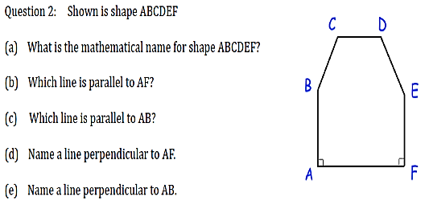


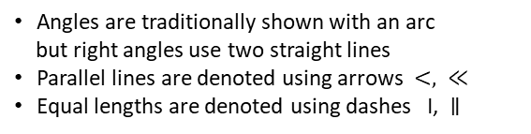






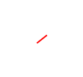


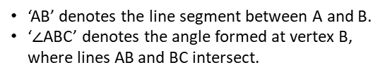

Pre-Skills – Geometric Notation
Learning outcome - to be able to identify angles and properties of shapes using notation.
Objectives:
Keywords:
Perpendicular
Parallel
Vertex
Understand the different types of notation for sides and angles.
Understand how to mark accurate notation on diagrams.
Definition
Characteristics
Geometric notation is the group of symbols which communicate geometric concepts, such as ‘parallel to’ or ‘perpendicular to’. They are a concise way to denote properties.
Angles are traditionally shown with an arc
but right angles use two straight lines
Parallel lines are denoted using arrows $<, ≪$
Equal lengths are denoted using dashes I, $∥$
Examples
Geometric Notation
Non - Examples
‘AB’ denotes the line segment between A and B.
‘$∠$ABC’ denotes the angle formed at vertex B, where lines AB and BC intersect.
The lengths are not all equal and the sides are not all parallel to each other.
The opposite sides are equal and parallel so we should use a different number of dashes and arrows for the 2 pairs of sides.
C
B
$$<$$
A
$$<$$
$$<$$
$$<$$
Example 1
I do…
We do…
You do…
Steps​ | Use geometric notation for sides with the following shapes
Recall shape names. | ​ ​ ​ ​ ​ ​ ​ ​ ​ ​ ​ ​ ​ | ​ ​
Recall geometric notation for sides.
Label the diagram.
D
D
$$<$$
$$−$$
$$−$$
C
C
$$<$$
$$<$$
E
$$<$$
E
$$<$$
$$=$$
B
$$=$$
A
B
$$<$$
$$<$$
$$<$$
A
F
What is the mathematical name for shape ABCDEF?
Which side is parallel to AF?
Mark on the diagram to show that sides BC and DE are equal in length.
Mark on the diagram to show that sides AB and EF are parallel and equal in length.
Which side is perpendicular to AB?
What is the mathematical name for shape ABCDE?
Which side is parallel to BC?
Which two sides are equal in length?
Which side is perpendicular to DE?
What is the mathematical name for shape ABCDEF?
Which side is parallel to DE?
Mark on the diagram to show that sides AB and EF are parallel.
Which side is perpendicular to EF?
Hexagon
CD
AF
Pentagon
AE
BC and CD
CD
Hexagon
BC
AF

Slide 4
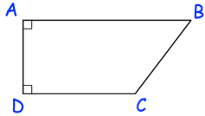
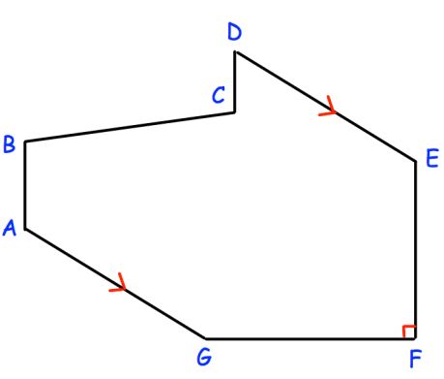
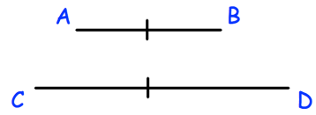










Independent Practice
1)
What is the mathematical name for shape ABCD?
Which side is parallel to AB?
Mark on the diagram to show that the sides in part b) are parallel.
Which side is perpendicular to AB?
$$<$$
Trapezium
CD
AD
$$<$$
2)
What is the mathematical name for shape ABCDEFG?
Which side is parallel to BC?
Mark on the diagram to show that sides AG and DE are parallel.
Mark on the diagram to show that sides AB and CD are equal in length.
Which side is perpendicular to AG?
Heptagon
FG
FG
B
$$<$$
C
A
$$−$$
$$−$$
D
$$<$$
$$<$$
E
G
$$<$$
F
3)
What is the mathematical name for shape ABCDEFG?
Which two sides are parallel?
Mark on the diagram to show that sides AB and EF are parallel.
Which two sides are equal in length?
Which side is perpendicular to EF?
Heptagon
AG and DE
EF and FG
FG
$$≫$$
$$≫$$
4)
Ranwah has been asked to draw a pair of parallel lines and to label them as parallel.
Explain her mistake.
She should have used a pair of arrows, not dashes.

Slide 5
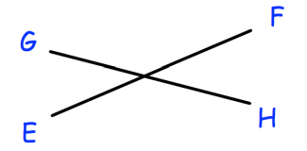







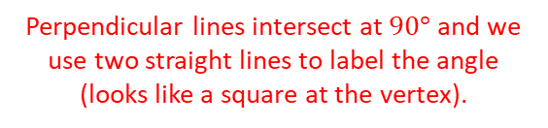














5) Nathan has been asked to draw a pair of perpendicular lines and to label them as perpendicular. Explain his mistake.
Perpendicular lines intersect at $90°$ and we use two straight lines to label the angle (looks like a square at the vertex).
Example 2
I do…
We do…
You do…
Steps​ | Use geometric notation for angles with the following shapes
Recall the types of angles. | ​ ​ ​ ​ ​ ​ ​ ​ ​ ​ ​ ​ ​ | ​ ​
Identify which angle the notation refers to (with the vertex on the middle letter)
Label the diagram.
B
C
B
A
B
$$105°$$
$$110°$$
$$y$$
C
A
$$y$$
C
$$x$$
A
$$y$$
$$x$$
D
$$135°$$
$$120°$$
$$36°$$
G
D
$$130°$$
F
F
E
$$x$$
E
E
D
What type of angle is $∠$EFG?
State the size of $∠$BAG.
State the size of $∠$DEF.
Mark $∠$BCD with a letter $x$.
Write angle $y$ in angle notation.
$∠$BCD = $∠$EFG, mark this on the diagram using arcs.
What type of angle is $∠$CDE?
State the size of $∠$AFE.
Mark $∠$CDE with a letter $x$.
Write angle $y$ in angle notation.
$∠$BCD = $∠$DEF, mark this on the diagram using arcs.
What type of angle is $∠$AEC?
State the size of $∠$BAE
Mark $∠$CDE with a letter $x$.
Write angle $y$ in angle notation.
$∠$DCE = $∠$DEC, mark this on the diagram using arcs.
Obtuse
$$105°$$
$∠$BAF
Acute
$$110°$$
$∠$BCE
Obtuse
$$90°$$
$$120°$$
$∠$ABC
Independent Practice
6)
What type of angle is $∠$BAD?
State the size of $∠$ADE.
Write angle $y$ in angle notation.
d) $∠$BCD = $∠$DEF, mark this on the diagram using arcs.
e) $∠$ABC = $∠$AFE, mark this on the diagram using arcs.
B
C
Acute
$$60°$$
$∠$AFE
A
$$60°$$
D
$$120°$$
$$y$$
F
E
5
5

Slide 6
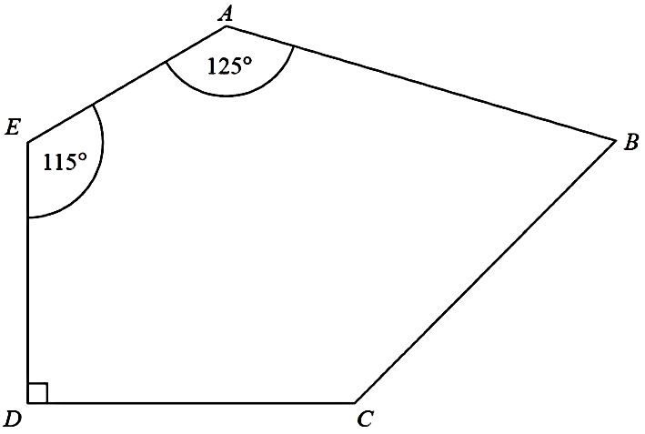
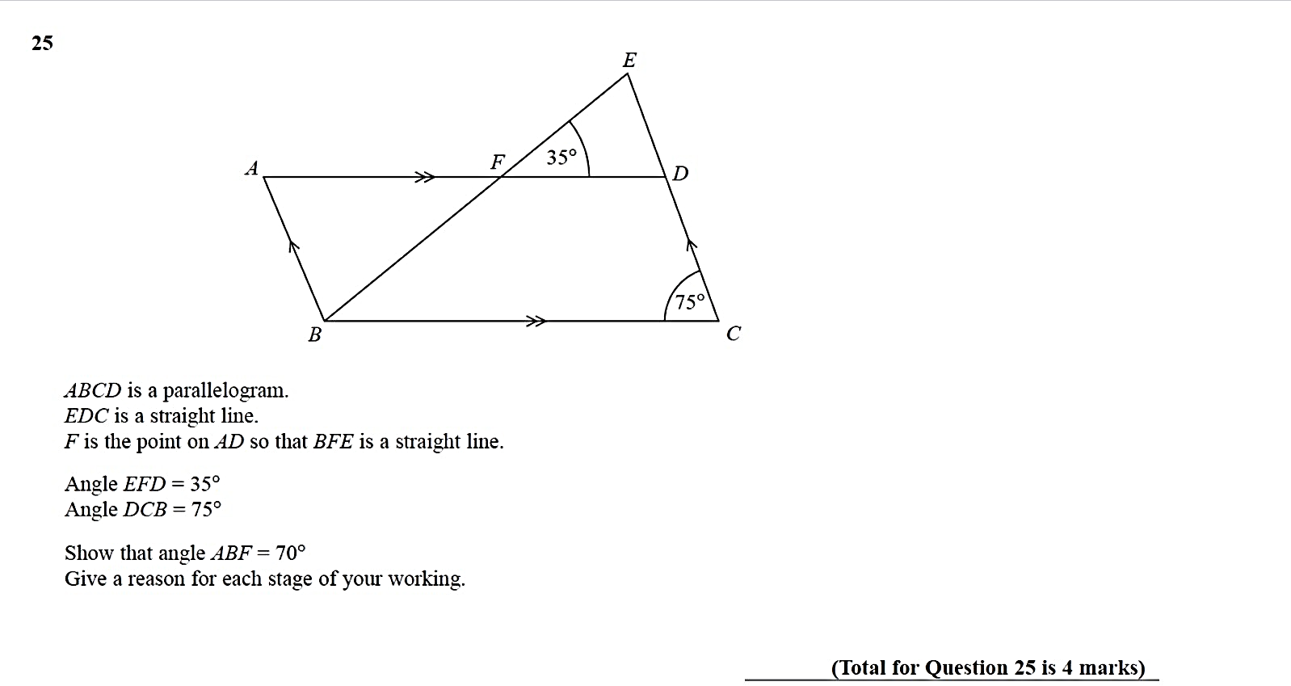




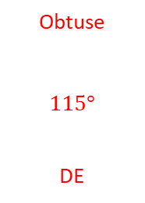




















7)
8)
9)
10)
What type of angle is $∠$DCB?
State the size of $∠$AED.
Which side is perpendicular to DC?
Sides AE and DE are equal, mark this on the diagram.
Obtuse
$$115°$$
DE
$$−$$
$$−$$
What type of angle is $∠$BCD?
State the size of $∠$FED.
$∠$FAB is $110°$, mark this on the diagram.
Which sides are parallel to each other?
Which sides are equal in length to each other?
f) $∠$ABC = $∠$DEF, mark this on the diagram using arcs.
Acute
$$165°$$
AF and CD
AB and EF, BC and DE
F
A
$$<$$
$$−$$
$$−$$
E
$$165°$$
B
$$=$$
$$=$$
$$85°$$
$$<$$
C
D
What type of angle is $∠$CDE?
State the size of $∠$FGH
Sides AC and GF and parallel, mark this on the diagram.
$∠$FGH = $∠$AHG, mark this on the diagram using arcs.
$∠$BCD = $∠$DEF, mark this on the diagram using arcs.
A
Reflex
$$140°$$
H
G
$$140°$$
$$<$$
B
$$<$$
F
$$82°$$
D
E
C
State the size of $∠$EFD.
State two pairs of parallel lines.
Which sides are equal in length to each other?
$∠$ADC = $∠$ABC, mark this on the diagram using arcs.
$$35°$$
AD and BC, AB and CD
AD and BC, AB and CD
$$=$$
$$−$$
$$−$$
$$=$$

Slide 7

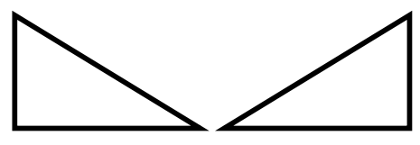
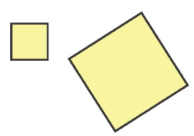
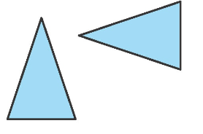
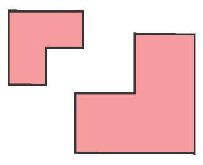
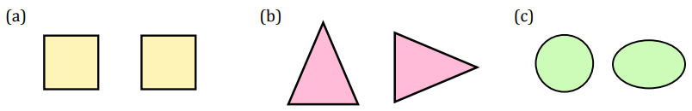
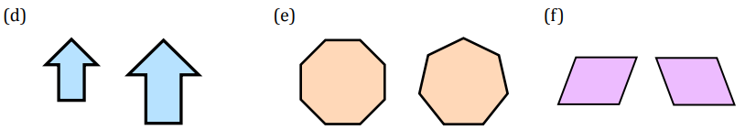






Subtopic 1 – Congruent Shapes
Learning outcome - to recognise congruent shapes.
Objectives:
Keywords:
Congruence
Corresponding
Recall the meaning of the word congruent.
Identify congruent shapes.
Definition
Characteristics
Two shapes that are the same size and the same shape are congruent. The shapes can be rotated or reflected but they must be identical.
Congruent shapes have:
corresponding angles that are the same size.
corresponding sides that are the same length.
For example:
If three sides of one triangle are equal to three sides of another triangle, the triangles are congruent.
Examples
These squares are congruent as they are exactly the same shape and the same size.
If one square was placed over the other they would fit precisely.
Congruent Shapes
Non - Examples
Despite these triangles looking like they are the same size and shape, they have different angles so are not congruent.
$$51°$$
$$50°$$
$$90°$$
$$39°$$
$$40°$$
$$90°$$
Example 1 I do…
We do…
You do…
Steps | State whether the pairs of shapes are congruent.
Check if the shapes are identical in size and shape.
If the shapes are identical, they are congruent.
Not congruent Congruent Not congruent
Independent Practice
1. For each pair of shapes, state whether they are congruent or not congruent.
a) | b) | c)
d) | e) | f)
Congruent Congruent Not congruent
Not congruent Not congruent Congruent
Notes:
No example

Slide 8
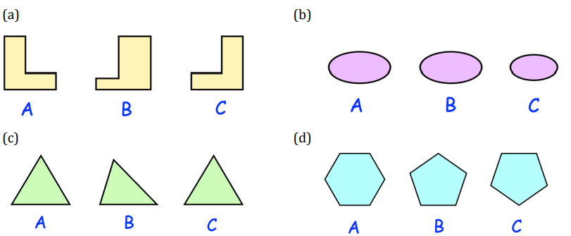
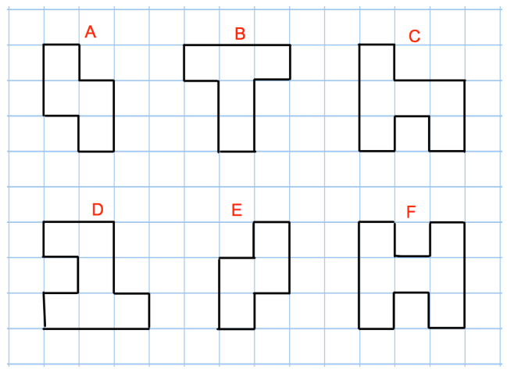
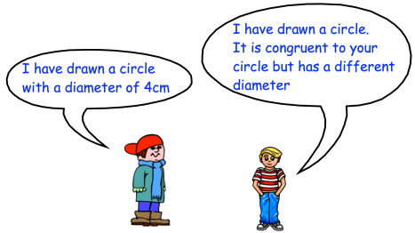
2. For each set of shapes, write down the shape that is not congruent to the others.
a) | b)
c) | d)
B C
B A
3. Here are six shapes. a) Which shape is congruent to shape E? b) Name two other congruent shapes.
A
C and D
4. Can Bawan be correct? Explain your answer.
No, as the diameters are different. They have to be the same for congruent shapes.
Logan
Bawan

Slide 9
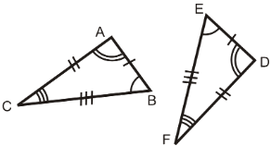
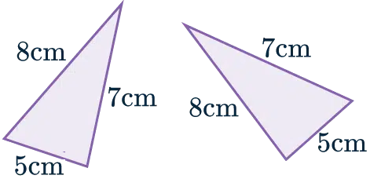
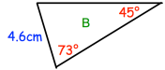

Subtopic 2 – Congruent Triangles
Learning outcome - to know and use triangle congruence rules.
Objectives:
Keywords:
Congruence
Triangle
Adjacent
Included
Understand the different rules of triangle congruence.
Identify congruent triangles.
Apply congruence rules to worded problems.
Definition
Characteristics
Two shapes that are the same size and the same shape are congruent. The shapes can be rotated or reflected but they must be identical.
For triangles to be congruent, four proofs are acceptable, either:
SSS (side, side side)
SAS (side, angle, side - angle between given sides)
ASA (angle, side, angle - side between given angles)
RHS (right angle, hypotenuse, side)
For example:
If three sides of one triangle are equal to three sides of another triangle, the triangles are congruent.
Congruent Triangles
Non - Examples
Examples
These two shapes are not congruent even though they look like they would satisfy the condition of ASA. This is because on shape B 4.6cm should be between the two angles to be congruent with shape A.
Example 1 I do…
We do…
You do…
You do…
Steps | State whether each set of triangles satisfy the condition SSS. Diagrams are not drawn to scale
Check for 3 corresponding sides, SSS (Side, Side, Side) You may have to convert units. 10mm = 1cm 100cm = 1m
If sides correspond, the triangles are congruent.
A
A
A
3cm
5m
A
4cm
7cm
4cm
6cm
7m
6cm
6m
7cm
B
9cm
C
B
9cm
C
B
C
X
X
B
C
X
X
9cm
7cm
6mm
9mm
6m
7m
60mm
70cm
Y
40mm
Z
Y
4mm
Z
Y
5m
Z
Y
30mm
Z
Yes
No
Yes
No
9

Slide 10








Independent Practice
State whether each set of triangles satisfy the condition SSS.
Diagrams are not drawn to scale!
a) | b)
c) | d)
e) | f)
g) | h)
i) | j)
A
X
A
X
3cm
4cm
4cm
4cm
5cm
6m
4m
2cm
B
2cm
C
Y
Z
B
6cm
C
Y
5m
Z
3cm
Yes
No
A
X
90mm
X
50mm
A
6cm
7cm
70mm
80mm
70mm
7cm
8cm
60mm
Y
B
C
Y
Z
9cm
Z
5cm
B
C
Yes
Yes
C
X
B
X
5000cm
600cm
5m
$$=$$
Z
6m
6m
Z
$$−$$
$$−$$
$$=$$
6m
$$−$$
$$=$$
B
6m
A
6000mm
A
C
Y
Y
Yes
No
B
42mm
Z
Z
4.2cm
Y
A
9m
$$−$$
0.18m
$$−$$
0.24m
Y
0.24m
35mm
42mm
A
3.5cm
C
18cm
X
B
C
X
Yes
0.09m
No
161mm
Z
Z
81cm
A
88mm
B
Y
Y
176mm
8.3mm
82cm
17.6cm
8cm
8.2mm
83cm
16.1cm
C
X
B
C
X
8.1mm
A
No
No
10

Slide 11

















Example 2 I do…
We do…
You do…
You do…
Steps | State whether each set of triangles satisfy the condition SAS. Diagrams are not drawn to scale
Check for 2 sides and the angle between them (the included angle), SAS (Side, Angle, Side) You may have to convert units. 10mm = 1cm 100cm = 1m
If sides and included angle correspond, the triangles are congruent.
A
A
A
C
B
5cm
$$50°$$
5m
C
6.4m
$$70°$$
30cm
$$42°$$
32cm
$$70°$$
C
5.2m
B
6cm
B
4m
B
A
X
X
C
X
Z
6cm
6.4m
42cm
$$32°$$
$$70°$$
Z
$$50°$$
5m
Y
Y
$$70°$$
30cm
5cm
4m
Y
5.2m
Z
Y
Z
X
Yes
No
Yes
No
Independent Practice
2. State whether each set of triangles satisfy the condition SAS.
Diagrams are not drawn to scale
a) | b)
c) | d)
e) | f)
A
X
A
X
1.3m
$$71°$$
$$71°$$
1.6m
1.6m
Y
Y
1.6m
1.6m
B
$$71°$$
B
$$71°$$
1.3m
1.3m
C
Z
1.3m
C
Z
Yes
No
A
X
A
X
$$34°$$
13cm
71mm
$$24°$$
16cm
Z
C
13cm
16cm
7.1cm
$$73°$$
52mm
$$73°$$
Z
B
C
Y
B
Y
5.2cm
No
Yes
C
B
3m
X
A
X
Y
$$42°$$
$$41°$$
40m
7cm
3cm
7cm
$$44°$$
40m
Z
$$42°$$
41m
44m
A
Z
B
C
Yes
Y
No

Slide 12

























Example 3 I do…
We do…
You do…
You do…
Steps | State whether each set of triangles satisfy the condition ASA. Diagrams are not drawn to scale
Check for 2 angles and the side between them (the included side), ASA (Angle, Side, Angle) You may have to convert units. 10mm = 1cm 100cm = 1m
If angles and included side correspond, the triangles are congruent.
A
A
A
C
B
$$50°$$
$$68°$$
5m
$$70°$$
C
30cm
$$60°$$
$$40°$$
$$77°$$
5.2m
$$52°$$
B
6cm
C
B
$$55°$$
B
A
X
X
C
X
Z
$$40°$$
6cm
$$55°$$
5.2m
$$52°$$
$$60°$$
Z
5m
Y
0.3m
Y
$$50°$$
$$70°$$
$$77°$$
Z
$$68°$$
Y
X
Y
Z
Yes
No
No
Yes
Independent Practice
3. State whether each set of triangles satisfy the condition ASA.
Diagrams are not drawn to scale
a) | b)
c) | d)
e) Think carefully! | f)
A
X
A
X
16cm
$$52°$$
16cm
Y
$$52°$$
$$52°$$
16cm
Y
$$52°$$
$$61°$$
$$61°$$
16cm
B
$$61°$$
Z
B
$$61°$$
Z
C
Yes
C
No
A
X
A
X
$$58°$$
$$84°$$
$$73°$$
7.1cm
13cm
130mm
Z
$$63°$$
C
$$84°$$
$$58°$$
$$73°$$
7.1cm
$$73°$$
Z
B
C
Y
B
Y
Yes
No
C
A
X
C
$$60°$$
B
$$73°$$
3cm
$$60°$$
A
$$73°$$
C
3cm
$$60°$$
$$73°$$
7.1cm
$$73°$$
Z
$$60°$$
B
Y
71mm
A
B
Yes
No

Slide 13
Example 4 I do…
We do…
You do…
You do…
Steps | State whether each set of triangles satisfy the condition RHS. Diagrams are not drawn to scale
Check for hypotenuse, right angle and side. Hint: The hypotenuse is always opposite the right angle. RHS (Right angle, Hypotenuse, Side) You may have to convert units.
If angle and sides correspond, the triangles are congruent.
A
A
B
19mm
B
1.2m
9cm
6cm
C
C
C
C
23mm
2.3m
B
7cm
B
3.5m
A
A
X
X
X
7cm
6cm
X
9cm
Y
230cm
Z
Z
19mm
23mm
3.5m
Z
Z
120cm
Y
Y
Y
Yes
No
No
Yes
Independent Practice
4. State whether each set of triangles satisfy the condition ASA.
Diagrams are not drawn to scale
a) | b)
c) | d)
e) Think Pythagoras! | f)
A
X
A
X
1.5cm
1cm
1.5m
1.5m
1.5cm
Z
Z
B
1cm
C
B
1m
C
1m
Y
Yes
Y
No
B
X
B
2.7m
X
8cm
C
Y
C
270cm
8.1cm
81mm
80mm
2.9m
A
Z
A
Z
230cm
Y
No
No
X
B
6m
X
B
3cm
C
8m
4cm
C
5cm
3cm
8cm
10m
Y
5cm
Z
Y
10m
6cm
A
4cm
Yes
A
Z
Yes

Slide 14


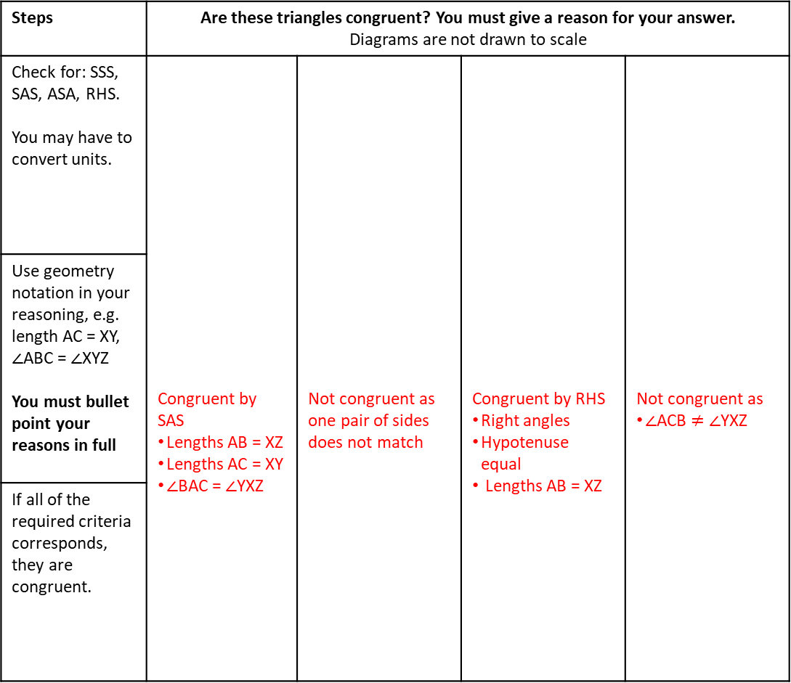

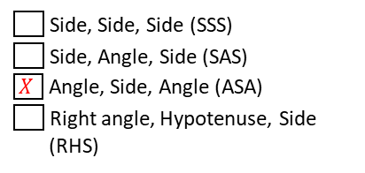



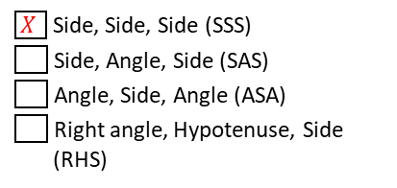


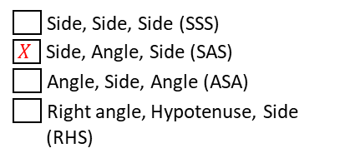



Example 5 I do…
We do…
You do…
You do…
Steps | Are these triangles congruent? You must give a reason for your answer. Diagrams are not drawn to scale
Check for: SSS, SAS, ASA, RHS. You may have to convert units. | Congruent by SAS Lengths AB = XZ Lengths AC = XY $∠$BAC = $∠$YXZ | Not congruent as one pair of sides does not match | Congruent by RHS Right angles Hypotenuse equal Lengths AB = XZ | Not congruent as $∠$ACB $≠$ $∠$YXZ
Use geometry notation in your reasoning, e.g. length AC = XY, $∠$ABC = $∠$XYZ You must bullet point your reasons in full
If all of the required criteria corresponds, they are congruent.
A
A
9cm
B
A
$$34°$$
16m
2cm
C
C
13m
7cm
8cm
$$63°$$
3cm
$$73°$$
7.1cm
B
C
B
C
A
B
X
X
X
3cm
X
$$34°$$
13m
$$73°$$
Z
7.1cm
8cm
Y
7.1cm
16m
2cm
$$73°$$
Y
9cm
Z
Z
Y
Z
Y
Independent Practice
5. Tick the correct reason of congruence for each set of triangles.
Diagrams are not drawn to scale
a) | b) | c)
C
B
X
A
12cm
7cm
6cm
A
9cm
$$55°$$
C
X
$$30°$$
Z
Y
Z
$$60°$$
18cm
A
7cm
$$30°$$
10cm
12cm
10cm
B
$$55°$$
18cm
Y
6cm
$$60°$$
B
9cm
C
Y
Z
X
Side, Side, Side (SSS)
$\boxed{X }$ Side, Angle, Side (SAS)
Angle, Side, Angle (ASA)
Right angle, Hypotenuse, Side
(RHS)
$\boxed{X }$ Side, Side, Side (SSS)
Side, Angle, Side (SAS)
Angle, Side, Angle (ASA)
Right angle, Hypotenuse, Side
(RHS)
Side, Side, Side (SSS)
Side, Angle, Side (SAS)
$\boxed{X }$ Angle, Side, Angle (ASA)
Right angle, Hypotenuse, Side
(RHS)

Slide 15

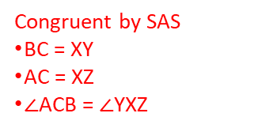




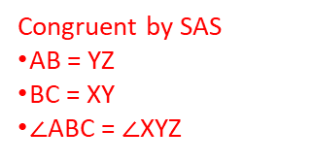



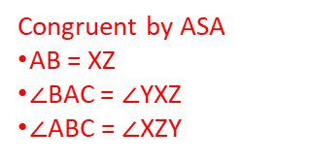




6. Are these triangles congruent? You must give full bullet pointed reason for your answer.
Diagrams are not drawn to scale
Y
a) | b)
c) | d)
e) | f)
g) | h)
A
Y
A
20cm
15cm
10cm
7cm
5cm
10cm
$$60°$$
$$60°$$
B
7cm
C
X
5cm
Z
B
15cm
C
X
Z
20cm
Congruent by SSS
AB = XZ
AC = XY
BC = YZ
Congruent by SAS
BC = XY
AC = XZ
$∠$ACB = $∠$YXZ
A
Y
A
Y
$$30°$$
12cm
12cm
B
$$70°$$
X
10cm
9cm
$$30°$$
9cm
$$70°$$
B
C
X
10cm
Z
C
Z
Congruent by RHS
Right angles
Hypotenuse equal
Length AB = XZ
Not congruent
9cm not the included side for both
A
Y
A
21cm
B
Y
20cm
X
3cm
$$60°$$
20cm
21cm
C
$$80°$$
C
X
$$60°$$
$$80°$$
Z
B
3cm
Z
Congruent by SAS
AB = YZ
BC = XY
$∠$ABC = $∠$XYZ
Congruent by ASA
AB = XZ
$∠$BAC = $∠$YXZ
$∠$ABC = $∠$XZY
A
Y
Y
35mm
48mm
A
1.9m
C
4.8cm
$$32°$$
4cm
1.5m
190cm
B
C
40mm
X
3.5cm
Z
$$32°$$
Congruent by SSS
AB = XZ
AC = XY
BC = YZ
B
X
150cm
Z
Congruent by SAS
BC = XZ
AC = XY
$∠$ACB = $∠$YXZ

Slide 16





























Example 6 I do…
We do…
You do…
Steps | Are these triangles congruent? You must give a reason for your answer. Diagrams are not drawn to scale!
Check for: SSS, SAS, ASA, RHS. You may have to convert units. You may have to find missing angles. You may need to use Pythagoras’ theorem You may have more information than needed.
Use geometry notation in your reasoning, e.g. lengths AC = XY, $∠$ABC = $∠$XYZ
If all of the required criteria corresponds, they are congruent.
A
B
C
$$30°$$
$$60°$$
6cm
$$30°$$
$$70°$$
4cm
5cm
$$100°$$
B
$$50°$$
A
Y
10 cm
C
$$70°$$
$$50°$$
X
6cm
$$80°$$
A
$$30°$$
$$60°$$
B
Z
C
$$50°$$
Y
5cm
$$70°$$
$$100°$$
$$70°$$
Y
$$30°$$
X
$$50°$$
Z
$$80°$$
10 cm
Z
X
Congruent by ASA
Lengths BC = XZ
$∠$ACB = $∠$XZY
$∠$ABC = $∠$YXZ
Not congruent as the included side is between a different pair of angles
Congruent by ASA
Lengths AC = YZ
$∠$ACB = $∠$XYZ
$∠$BAC = $∠$XZY
Independent Practice
7. Are these triangles congruent? You must give a reason for your answer.
Diagrams are not drawn to scale!
X
a) | b)
c) | d)
B
Z
A
$$80°$$
$$40°$$
Y
42cm
$$50°$$
Y
$$70°$$
$$40°$$
42cm
$$60°$$
1.6cm
$$60°$$
1.3cm
$$70°$$
$$60°$$
$$50°$$
$$80°$$
$$60°$$
A
38cm
C
X
B
1.3cm
C
Z
Congruent by ASA
Lengths AB = XY
$∠$ABC = $∠$YXZ
$∠$BAC = $∠$XYZ
Not congruent
B
38cm
B
5cm
13cm
42cm
Y
Z
12cm
C
X
Z
$$−$$
$$30°$$
42cm
42cm
$$−$$
$$30°$$
13cm
12cm
A
C
42cm
A
Y
38cm
X
Congruent by RHS
Right angles
Hypotenuse equal
Length AB = YZ
Congruent by SAS
AB = BC = XY = XZ
$∠$ACB = $∠$YXZ

Slide 17


8. Write down whether each statement is always true, sometimes true or never true.
b) When a triangle is reflected in a line, the object and image are congruent. | b) When a triangle is rotated about a point, the object and image are congruent.
c) When a triangle is translated with a column vector, the object and image are congruent. | d) When a triangle is enlarged from a point, the object and image are congruent.
Always
All sides and angles are exactly the same in the original shape and its image.
Always
All sides and angles are exactly the same in the original shape and its image.
Always
All sides and angles are exactly the same in the original shape and its image.
Sometimes
If they use scale factors 1 or -1, all sides and angles are exactly the same in the original shape and it’s image.
If they use any other scale factor they won’t be congruent as the sides will be different lengths.
9. Jez says that these two triangles are congruent because two angles and a side are the same. Explain why he is wrong.
The side that is the same is not between the same 2 angles, therefore not ASA.

Slide 18





Skills Check
1) Which congruency condition do these triangles satisfy?
2) Which congruency condition do these triangles satisfy?
3) Which pair of triangles are congruent?
4) Which congruency condition do these triangles satisfy?
A | SSS - Side, Side, Side
B | SAS - Side, Angle, Side
C | ASA - Angle, Side, Angle
D | RHS - Right angle, Hypotenuse, Side
A
Y
A | SSS - Side, Side, Side
B | SAS - Side, Angle, Side
C | ASA - Angle, Side, Angle
D | RHS - Right angle, Hypotenuse, Side
20cm
15cm
B
$$40°$$
C
$$40°$$
15cm
X
Z
20cm
A | A and B
B | B and C
C | A and D
D | Not enough information
A | SSS - Side, Side, Side
B | SAS - Side, Angle, Side
C | ASA - Angle, Side, Angle
D | RHS - Right angle, Hypotenuse, Side
Score ……/4

Slide 19









Subtopic 3 – Congruence Proofs
Learning outcome: Use knowledge about congruence to complete proofs.
Objectives:
Keywords:
Congruence
Proof
1. Prove how two shapes are congruent.
2. Find triangles within different shapes.
3. Give clear mathematical reasoning.
Definition
Characteristics
Using mathematical reasoning to explain why two shapes are congruent.
Involves several stages of working.
Every step is explained.
For example:
If three sides of one triangle are equal to three sides of another triangle, the triangles are congruent.
Examples
Congruence Proofs
Non - Examples
A
B
A
B
O
Triangles AOD and BOC are congruent.
O
Triangles AOD and AOB are not congruent.
D
C
D
C
Example 1 - I do…
We do…
You do…
ABCD is a parallelogram, where lines AC and BD pass through the centre point O. Prove that the triangles AOD and BOC are congruent. | ABCD is a rectangle, where lines AC and BD pass through the centre point O. Prove that the triangles AOD and BOC are congruent. | ABCD is a rectangle, where lines AC and BD pass through the centre point O. Prove that the triangles AOB and COD are congruent.
A
B
A
B
A
$$−$$
B
$$−$$
O
$$−$$
$$−$$
O
$$−$$
O
D
C
D
C
D
$$−$$
C
$∠$ADB = $∠$CBD as alternate angles are equal.
$∠$CAD = $∠$ACB as alternate angles are equal.
Lengths AD = BC as opposite sides in a parallelogram are equal.
Hence triangles AOD and BOC are congruent by ASA.
$∠$ADB = $∠$CBD as alternate angles are equal.
$∠$CAD = $∠$ACB as alternate angles are equal.
Lengths AD = BC as opposite sides in a rectangle are equal.
Hence triangles AOD and BOC are congruent by ASA.
$∠$BAC = $∠$ACD as alternate angles are equal.
$∠$ABD = $∠$BDC as alternate angles are equal.
Lengths AB = CD as opposite sides in a rectangle are equal.
Hence triangles AOD and BOC are congruent by ASA.
There are multiple possible proofs
Notes:
Learning outcome needs changing

Slide 20








GCSE Questions: Congruence Proofs
1. The diagram shows a parallelogram split across a diagonal. Prove that ABD and CBD are congruent.
2. ABCD is a parallelogram. E is the point where AC and BD meet. Prove ADE and BCE are congruent triangles.
3. ABDC is a parallelogram. Prove that the triangle ABC is congruent with the triangle BCD.
4. ABC is an equilateral triangle. D lies on BC. AD is perpendicular to BC. Prove that triangles ACD and ADB are congruent.
$∠$BCD = $75°$ as opposite angles in a parallelogram are equal.
Lengths AB = CD as opposite sides in a parallelogram are equal.
Hence triangles ABD and CBD are congruent by ASA.
$∠$BAC = $∠$BDC as opposite angles in a parallelogram are equal.
Lengths AB = CD and AC = BD as opposite sides in a parallelogram are equal.
Hence triangles ABC and BCD are congruent by SAS.
$∠$ADC = $∠$ADC = $90°$
Lengths AB = AC (both hypotenuse) as ABC is an equilateral triangle and all sides are equal.
Both triangles ACD and ADB share the side AD.
Hence triangles ABC and BCD are congruent by RHS.

Slide 21











5. ABCD is a quadrilateral. AB = AD BC = CD Prove that the triangles ABC and ACD are congruent.
6. ABCD is a rhombus. M and N are points on BD such that DN = MB. Prove that triangle DNC is congruent to triangle BMC.
7. ABCD is a parallelogram. ABP and QDC are straight lines. Angle ADP = angle CBQ = 90° Prove that triangle ADP is congruent to triangle CBQ.
8. The diagram shows a triangle ADE. AE = DE AB : BC : CD = 1 : 2 : 1 Prove that triangle ACE is congruent to triangle DBE.
$$−$$
$$−$$
Lengths AB = AD and BC = CD as given.
Both triangles ABC and ACD share the side AC.
Hence triangles ABC and ACD are congruent by SSS.
$$=$$
$$=$$

Slide 22







9. PQ = PR. S is the midpoint of PQ. T is the midpoint of PR. Prove triangle QTR is congruent to triangle RSQ.
10. In the diagram, ADE is a right-angled triangle, ABCD and AEFG are squares. Prove that triangle ABE is congruent to triangle ADG.
11. A and C are points on a circle, centre $O$. AB and BC are tangents to the circle. Prove ABO and BOC are congruent triangles.
Lengths AO = CO as they are radii of the same circle.
$∠$BAO = $∠$BCO = $90°$ as the angle between a tangent and a radius is equal to $90°$
Triangles ABO and BOC share the side BO, which is the hypotenuse.
Hence triangles ABO and BOC are congruent by RHS.

